Slide 1

Microwave Oven Controller Using PIC16F877A
Simulation Based Embedded Systems Project
Presented By : Baba Shareef Shikilghar
Stream : B.Tech ECE
College : Sri Venkateswara College of Engineering

Slide 2

Internship Overview
About Emertxe Technologies: A leading institution focused on embedded systems training and development, providing hands-on experience with cutting-edge technologies.
Duration of Internship: A comprehensive 4-week program designed to immerse interns in practical embedded systems projects.
Domain: Specializing in Embedded Systems, with a focus on microcontroller-based applications.
Technologies Learned: Gained proficiency in various embedded tools, programming languages, and hardware interfacing techniques.

Slide 3




Key Goals of the Internship
Embedded System Fundamentals
Microcontroller Programming
Deep dive into the core concepts and architecture of embedded systems.
Mastering the art of writing efficient code for microcontrollers like PIC16F877A.
Interface Peripherals
Develop a Real-Time Project
Hands-on experience with connecting and controlling various external devices.
Applying learned skills to build a functional embedded system application from scratch.

Slide 4
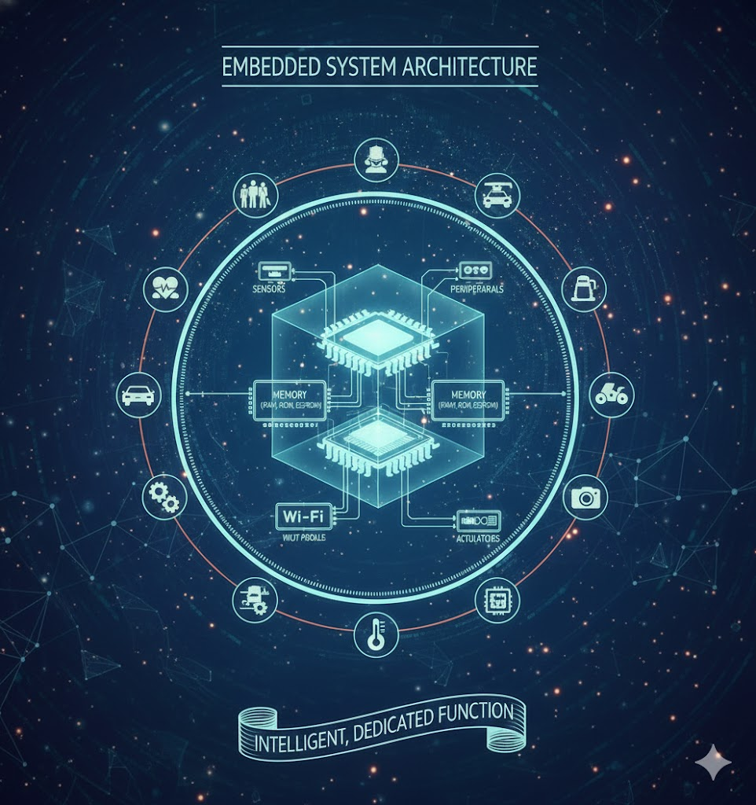
Introduction to Embedded Systems
What are Embedded Systems?
An embedded system is a computer system—a combination of a computer processor, computer memory, and input/output peripheral devices—designed for a specific function within a larger mechanical or electrical system.
Basic Components
Microcontroller/Microprocessor
Memory (RAM, ROM, EEPROM)
Input/Output Ports
Sensors & Actuators
Diverse Applications
Consumer Electronics (Microwaves, Washing Machines)
Automotive (Engine Control Units)
Industrial Automation
Medical Devices

Slide 5
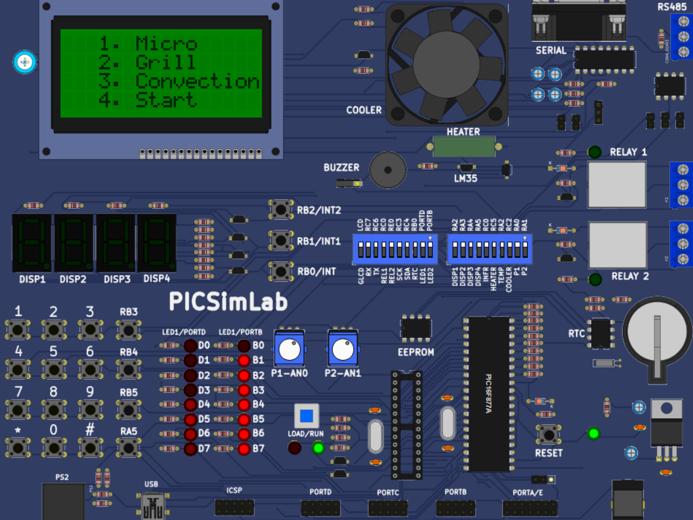
Project Objective: Microwave Oven Simulation
Simulation: Developing a virtual model of a microwave oven using the PIC16F877A microcontroller.
Multiple Operating Modes: Implementing distinct modes such as Microwave, Grill, and Convection for versatile cooking.
User Interface: Designing an intuitive interface using a 4x4 matrix keypad for input and a 16x4 LCD for displaying information.
Timer and Fan Control: Integrating precise timer functionalities and controlling a fan for proper ventilation and heat distribution.

Slide 6






Comprehensive Project Features
Microwave Mode
Grill Mode
Standard heating with displaying power level.
Crisping and browning functionalities.
Convection Mode
Start Mode
Even baking and roasting with temperature control.
Quick start option for default cooking durations.
Time Settings
Control Functions
User-defined time settings.
Full control with Start, Pause, Resume, and Stop operations.

Slide 7

System Block Diagram
Cooling Fan
4x4 Matrix Keypad
Operational output device
User input for controls
Microwave System Block
16x4 LCD Display
PIC16F877A Controller
Shows user instructions
Central processing unit
This diagram illustrates the flow of control and data within the microwave oven simulation system. The Keypad serves as the primary input, the PIC16F877A as the central processing unit, and the LCD and Fan as visual and functional outputs respectively.

Slide 8

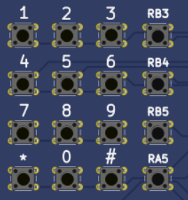
Hardware Description: Key Components
PIC16F877A Microcontroller Board
4x4 Matrix Keypad

Slide 9
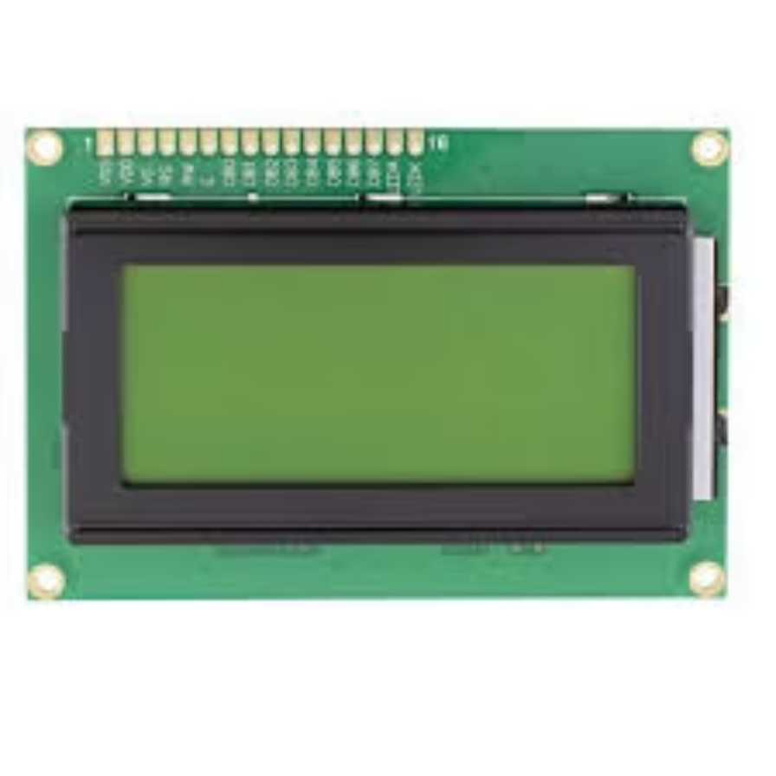
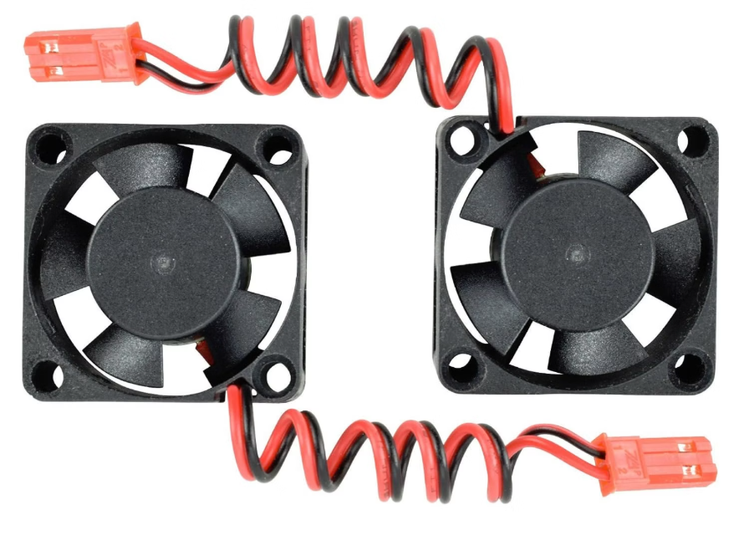
16x4 LCD Display
Fan

Slide 10
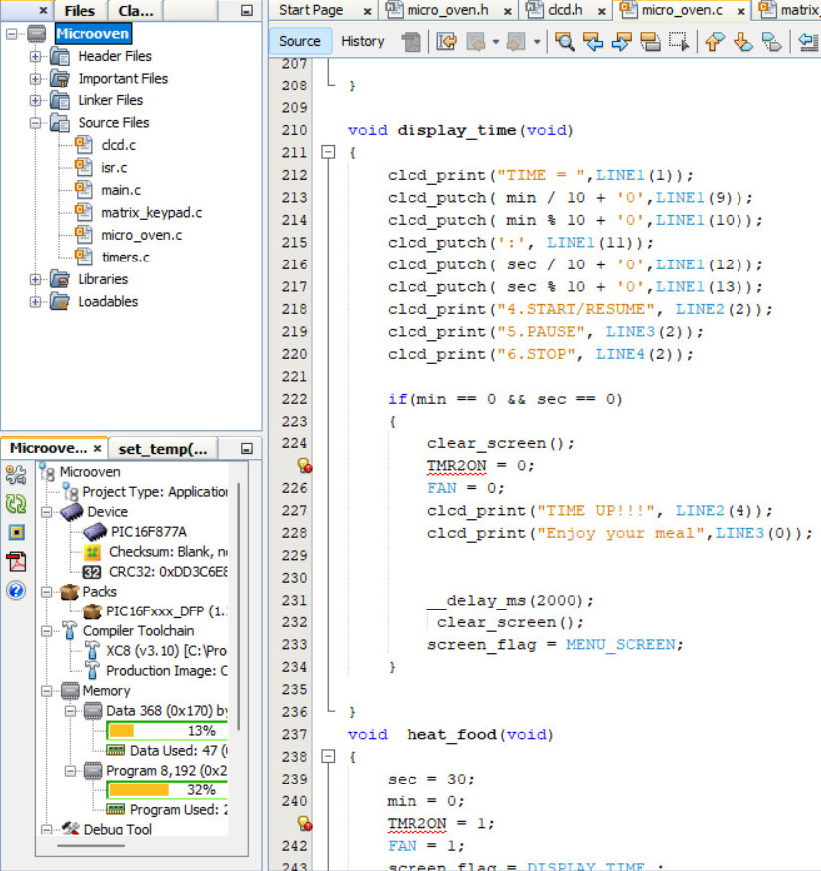
Software Development Environment
MPLAB IDE: The integrated development environment (IDE) provided by Microchip, used for writing, compiling, and debugging the Embedded C code.
Embedded C (XC8 Compiler): The programming language used to develop the control logic for the PIC16F877A microcontroller. The XC8 compiler translates the C code into machine-readable instructions.
PICSIMLAB Simulator: A powerful simulation tool that allows testing and debugging the microcontroller code without the need for physical hardware. This was crucial for validating the project's functionality.

Slide 11




Operating Modes: Microwave Mode & Grill Mode
Time Setting
Control Functions
Precise control over cooking duration for optimal results.
Intuitive Start, Pause, Resume, and Stop operations for user convenience.
Fan Operation
Power Display
Integrated fan management for even heat distribution and ventilation.
Real-time power level visualization in Microwave Mode.

Slide 12
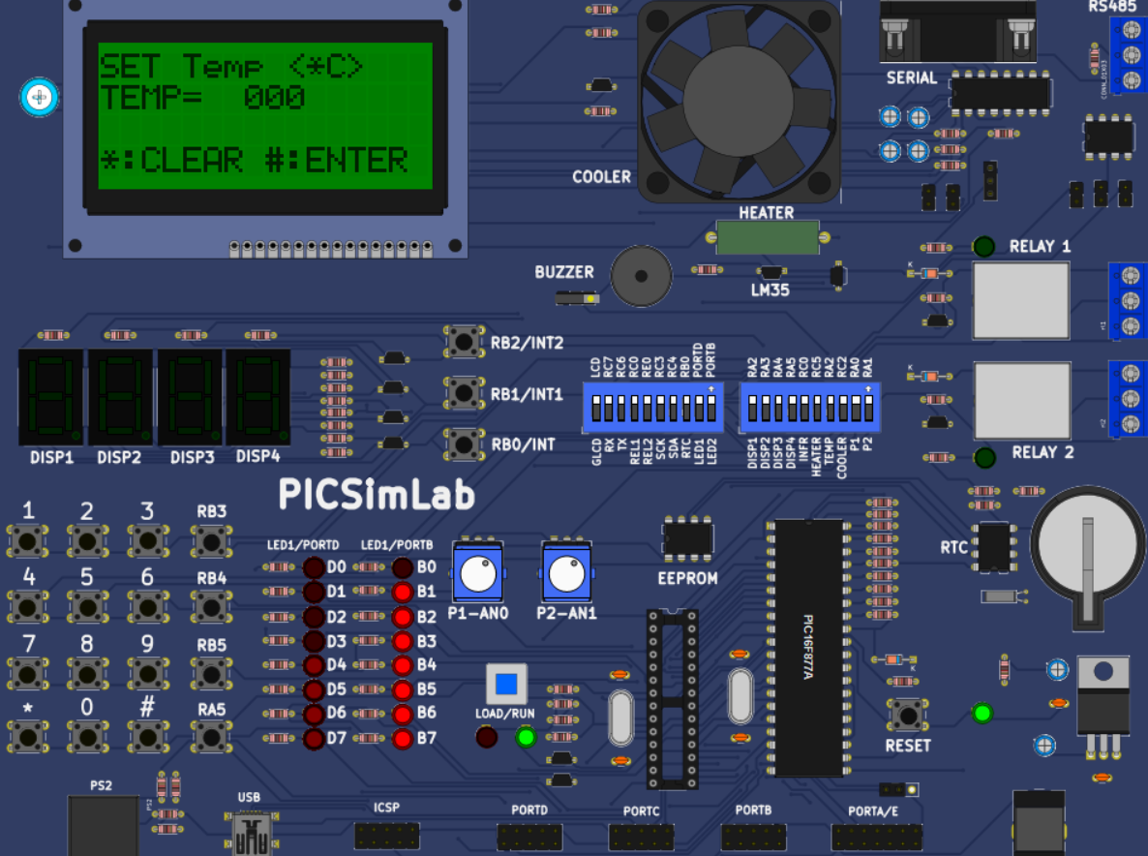
Operating Mode: Convection Mode
Temperature Setting Precise temperature calibration for various convection cooking needs.
Preheating Rapid 60-second preheating function for efficient cooking.
Time Setting Configurable timers to ensure dishes are cooked to perfection.
Fan Operation Continuous fan circulation for consistent heat and optimal baking/roasting.

Slide 13
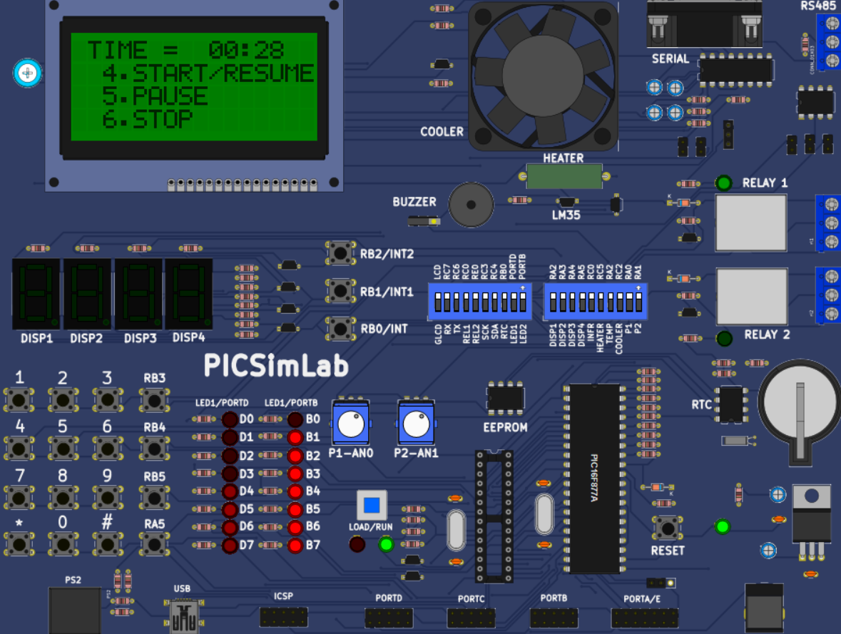
Operating Mode: Start Mode
Default 30 Seconds
Increment Time
Instant cooking with a one-touch 30-second default setting.
Easily add cooking time in 30-second intervals.
Dynamic Controls
Seamless Pause, Resume, and Stop functions during quick operations.

Slide 14


Challenge & Solution: LCD Content Overlapping
The Overlapping Conundrum
Challenge: Content on the LCD screen overlaps because the screen is not cleared before new data is displayed, causing visual clutter and confusion. This issue makes data unreadable and significantly impacts user experience.
The Clear Solution
Solution: Implementing the LCD clear function before updating the display ensures the screen is reset. This simple yet critical step prevents overlap and maintains clear, readable output, enhancing operational efficiency.

Slide 15






Key Learning Outcomes
Embedded C Programming
Mastery of C for microcontrollers, enabling efficient system control.
PIC16F877A
In-depth understanding of the microcontroller's internal structure and functionality.
Keypad Interfacing
Techniques for integrating and managing user input through a keypad matrix.
LCD Interfacing
Skills in connecting and programming Liquid Crystal Displays for output.
Timer Configuration
Setting up and utilizing hardware timers for precise timing and event handling.
Simulation & Debugging
Proficiency in simulating embedded systems and debugging code effectively.

Slide 16





Future Enhancements
Real Hardware Implementation
Door Safety Sensor
Buzzer Indication
Transitioning from simulation to a physical, working prototype.
Implementing a critical safety feature to prevent operation with an open door.
Adding audio cues for end-of-cycle and other important events.
IoT Based Remote Control
Temperature Sensor Integration
Enabling smartphone control for enhanced convenience and smart home integration.
Adding a sensor for precise temperature monitoring during cooking.

Slide 17

Thank You!

